Slide 1
Data Pre Processing Steps

Slide 2
Context
We currently have 228 images of damaged walls captured in our campus areas
Each image has 1 or more classes (cracked wall, damp wall, peeled paint, no defect) that we need to classify in our ML model
These images also has various noise i.e. things which are not a wall
So generating dataset first from these noisy images and then labelling them will take days of manual work
In this presentation, we propose an easy way of generating dataset with least amount of manual work

Slide 3
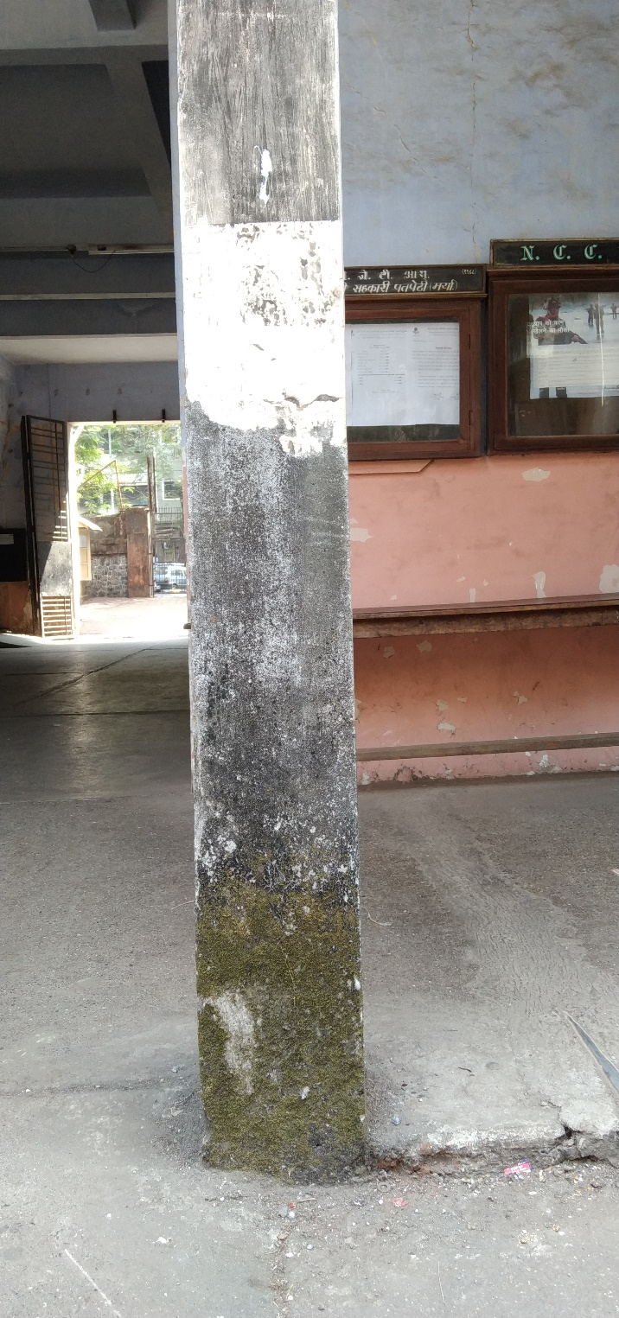
Example
Let us take an example image of one of our captured images

Slide 4
Divide the images into classes
The image on the previous slide can be divided into classes as follows
Red = Not a wall
Blue = No defect
Black = Fungus (Damp wall)
Pink = Peeled paint
Green = Algae (Damp wall)
There is no crack in this image
We will consider fungus and algae in the same class as “Damp wall”

Slide 5
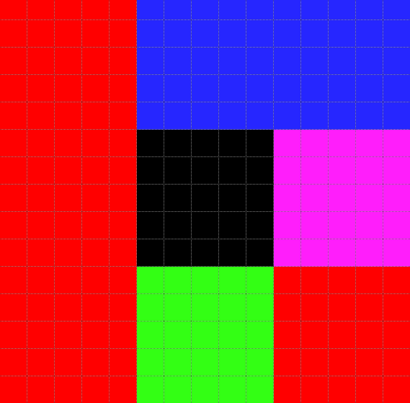

Slide 6
How to divide the image into classes
The division of image is done manually
But as the divided image would be as pure as possible (sub image comprising of only one class), the amount of noise would be reduced
This cropped image would be placed in a folder of a specific class
Currently we have taken 20 such sub images each of dimensions (300*300) for each class (total 80)
The above 20 sub images are taken from different images to increase the variation in the dataset

Slide 7
Process each divided class
For each sub image of 4 classes, we would generate all possible (256*256) window images
These generated window images would be a part of our final dataset
We will be using sliding window mechanism to generate these dataset (first few iterations illustrated in next slide)
We are not applying any synthetic transformations such as rotation, scaling, etc.

Slide 8
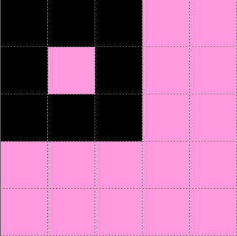
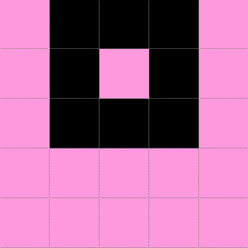
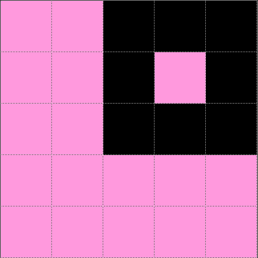
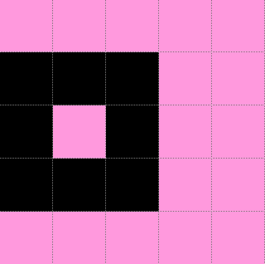

Slide 9
Benefit and results
For each (300*300) image, we are getting (300-256+1)^2 = 2025 (256*256) images each labelled with same class as the input (300*300) image
Thus for 80 such labelled (300*300) images, we are obtaining (2025*80) = 1,62,000 labelled (256*256) images
We can increase the number of samples (currently 80) to increase the volume of the dataset and reduce the cropping window size (currently 300*300) to increase the variation

Slide 10
Benefits and results (cont.)
The sliding window mechanism generates images that are a column/row of pixel different, which although would look similar to humans but will be different to ML model
We are working on building ML model to be trained from this dataset
We are hoping to get good accuracy from this method

